Slide 1
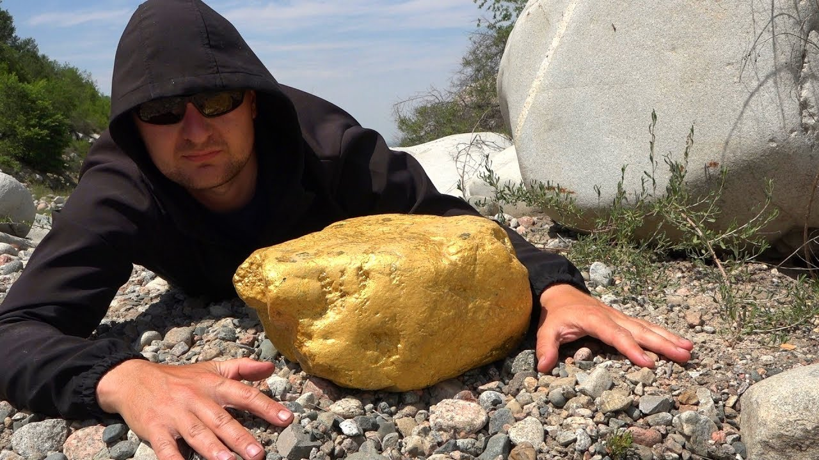
The Upper Reaches of the Sierra Nevada Auriferous Gold Channels, California and Nevada
Larry Garside, Christopher Henry, James Faulds and Nicholas Hinz 2005

Slide 2
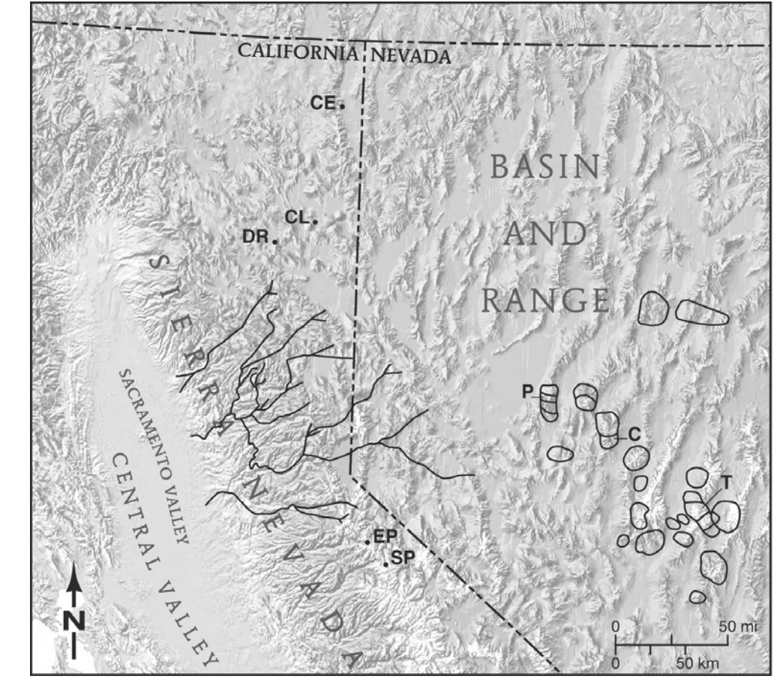
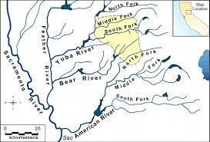
Intro
Tertiary Yuba and American rivers (left) and modern (up).
Paleoriver were initially mapped by Lindgren (1911).

Slide 3
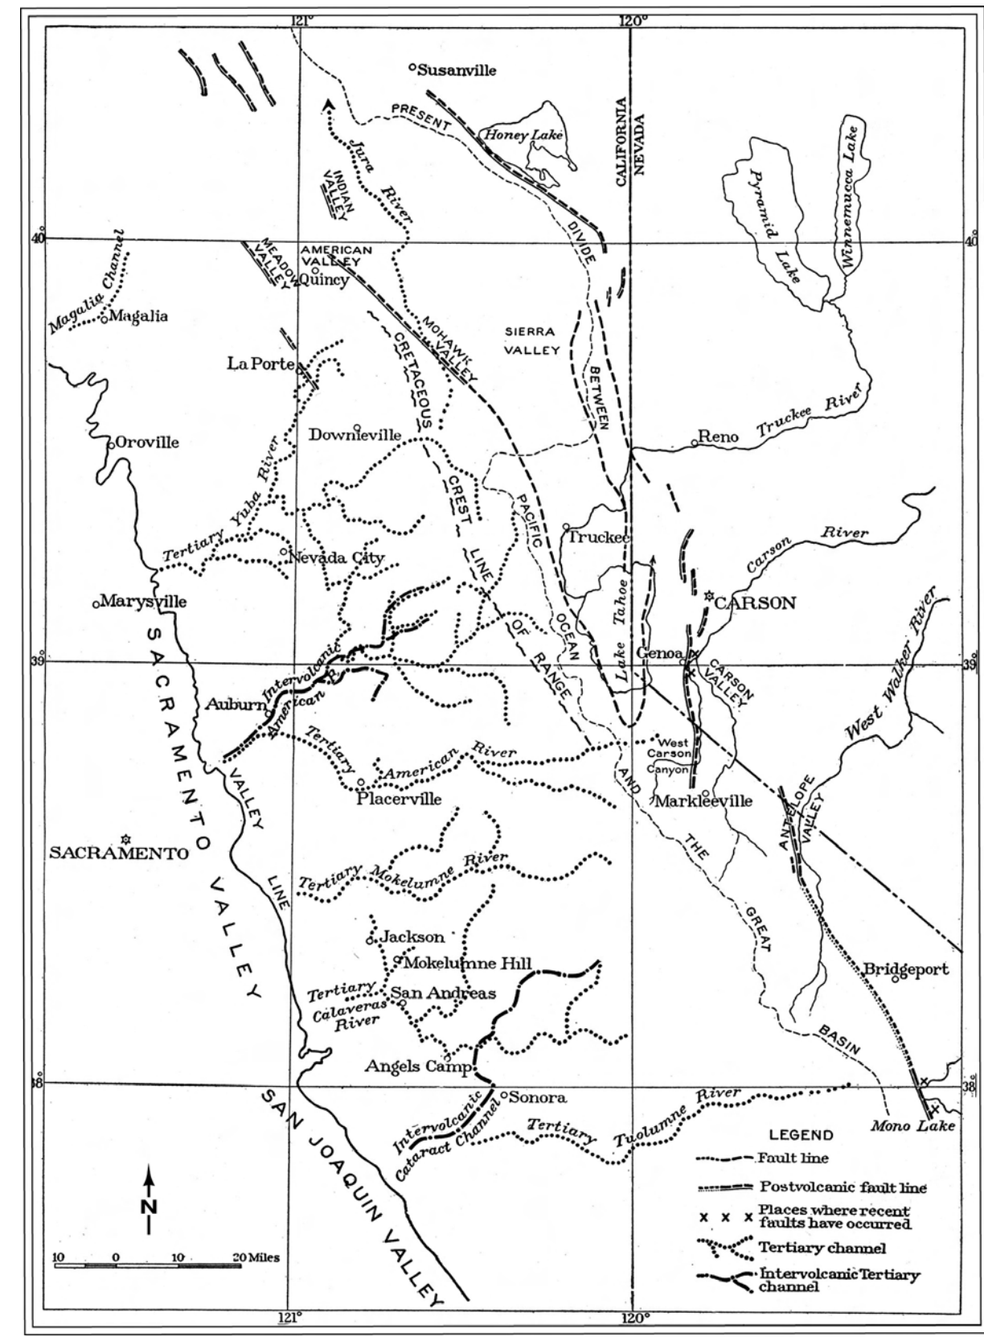
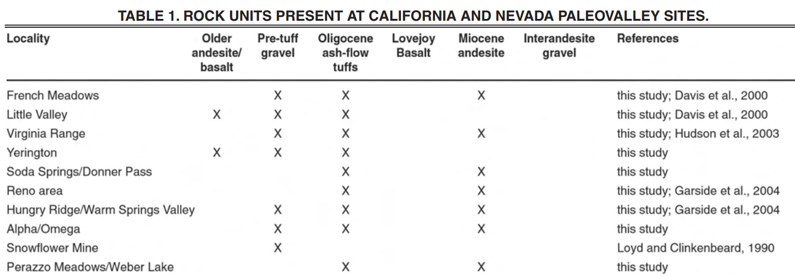
Early forensics suggested that gold bearing gravels (Auriferous gravels) originated no further East than the present crest (West of Tahoe).
Lindgren concluded uplift of Sierra and dropping of Basin and Range occurred in the late Cretaceous.
Which is why Lindgren drew Eocene river heads nearby crest (somewhat East of present divide).
Also posited another river called the Jura which was later debunked.

Slide 4
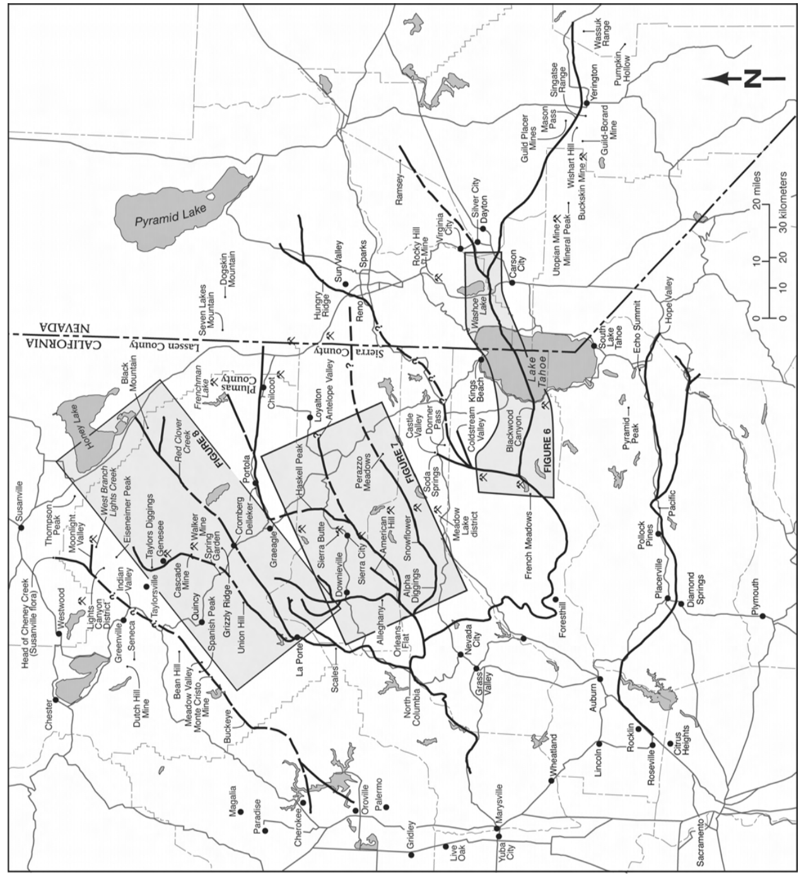
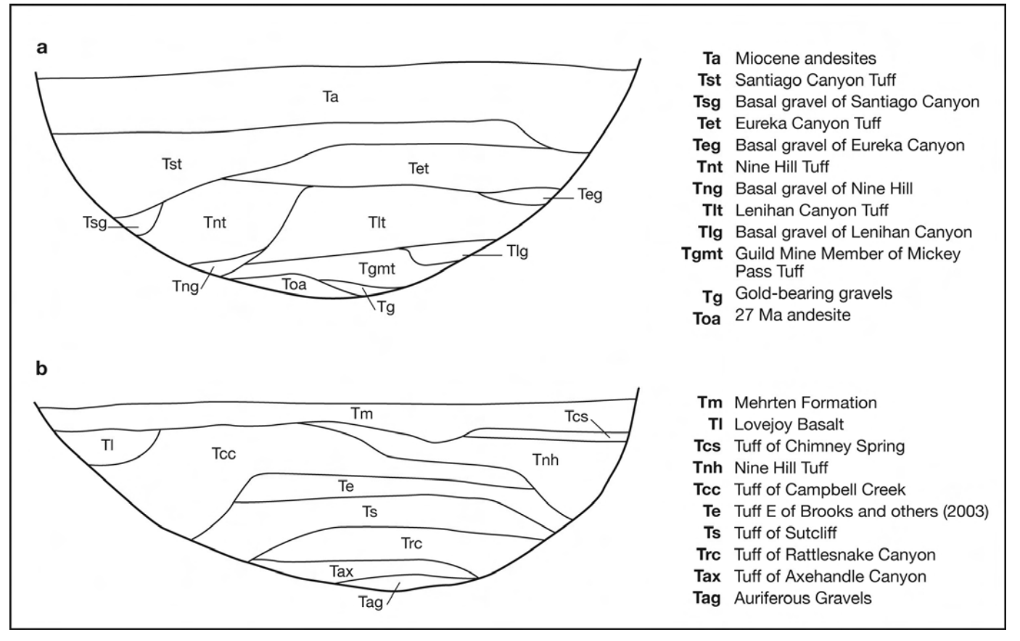
Geology
. Considerable erosion 80-30 Ma.
. Volcanic eruption happening at the same time.
. Materials were transported West across what was to become Sierra Nevada mountains.

Slide 5
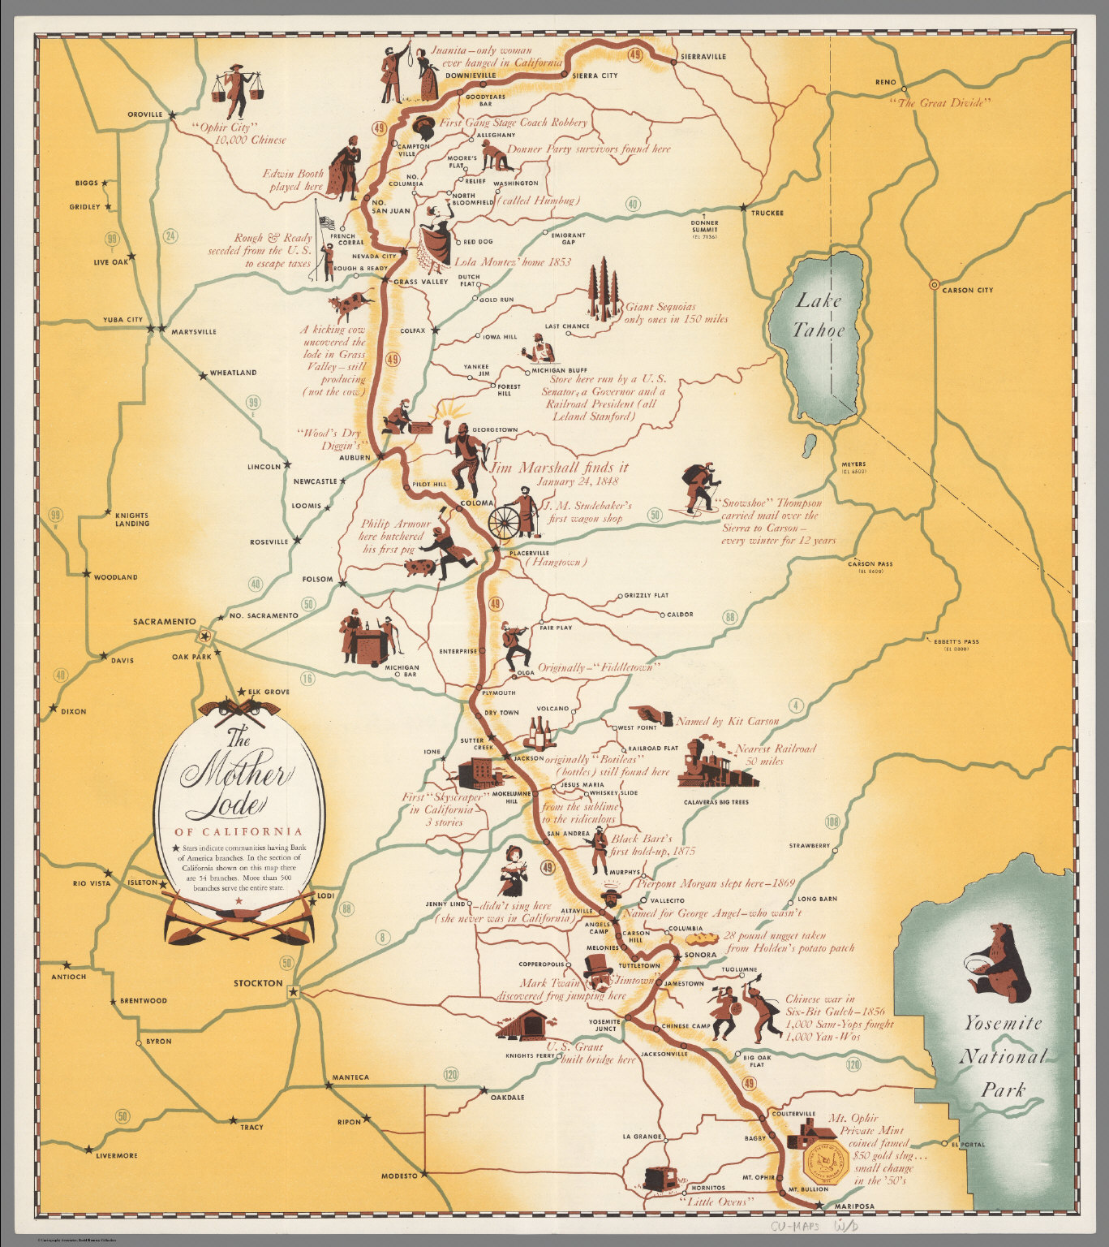
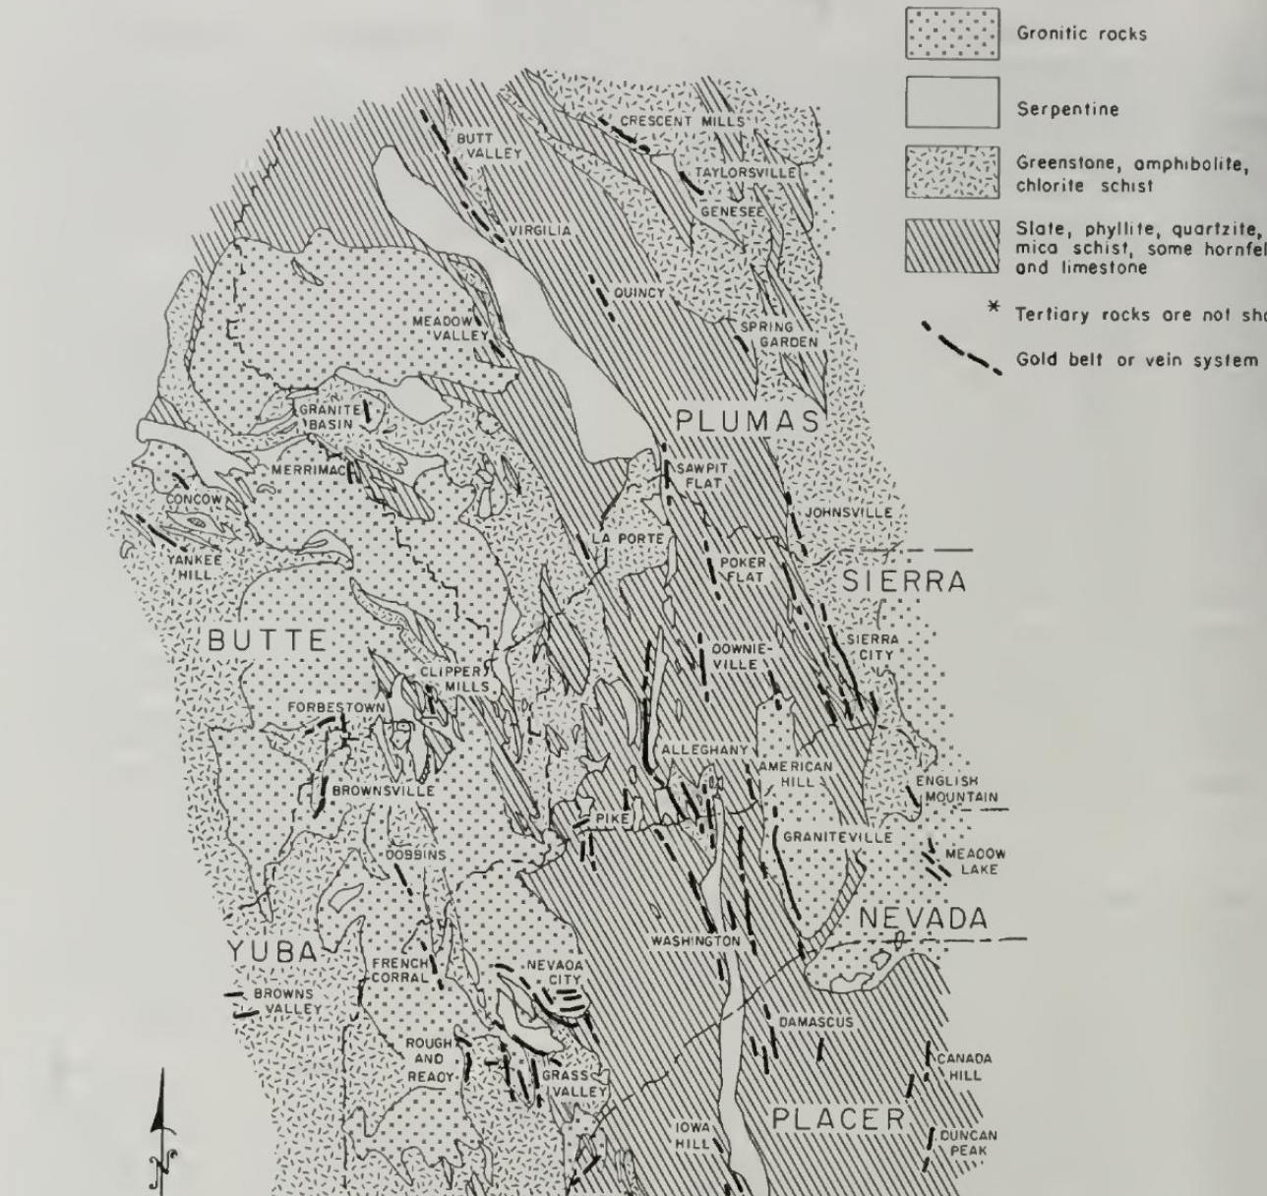
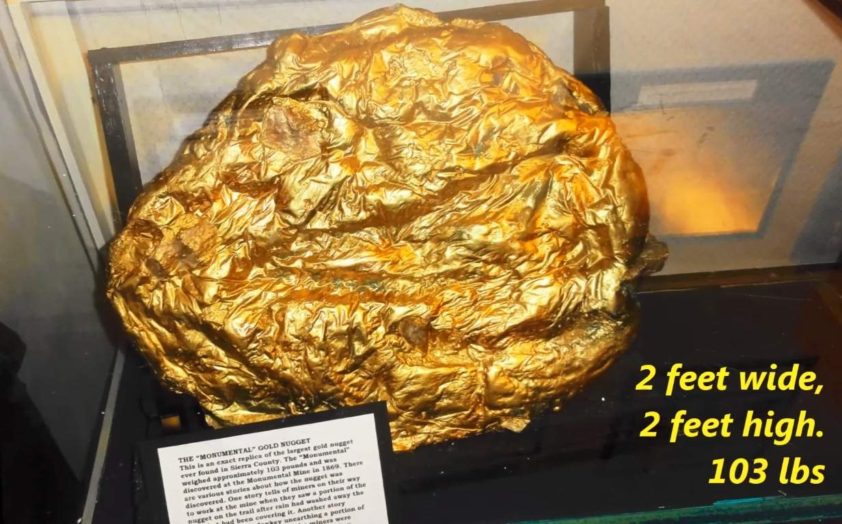
Gold
Gold found in Eocene paleo-valleys were probably eroded from quartz higher up.
Clark (1970) - majority of gold deposits in northern CA occur West of Tahoe area.
2.1 M now -- 0.183 M in 1977

Slide 6
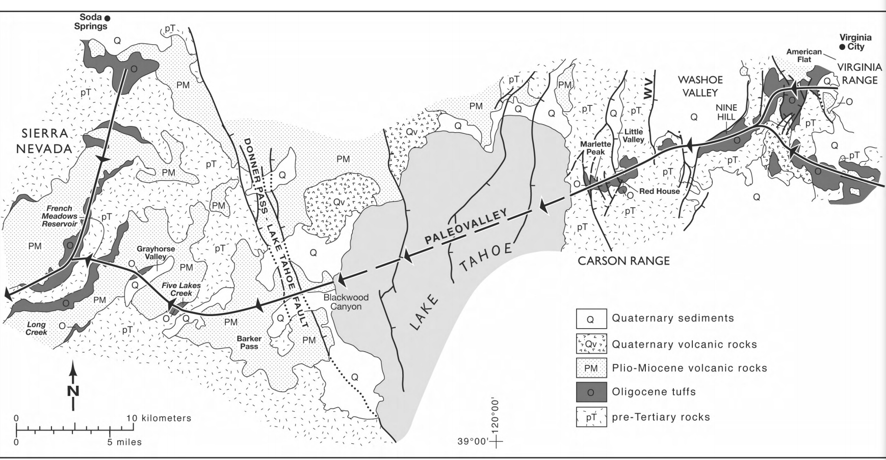
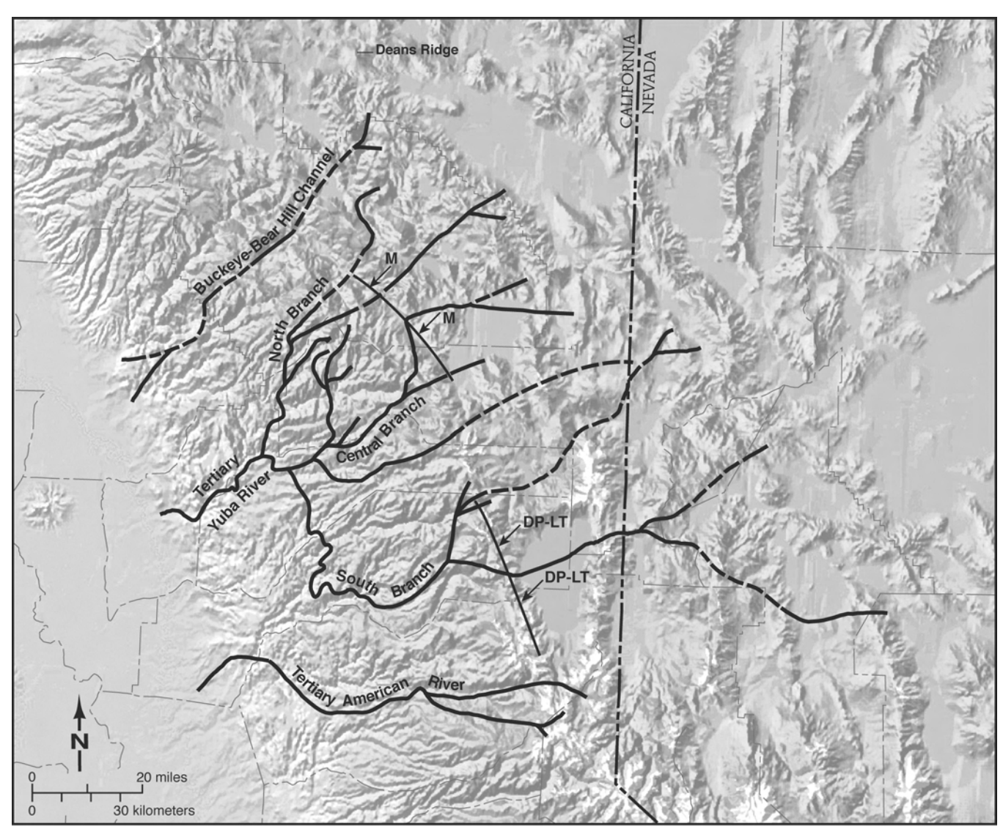
Southern Branch of the Tertiary Yuba River
Tertiary channel is based on the outcrops of Oligocene ash-flow tufts and their elevations.

Slide 7
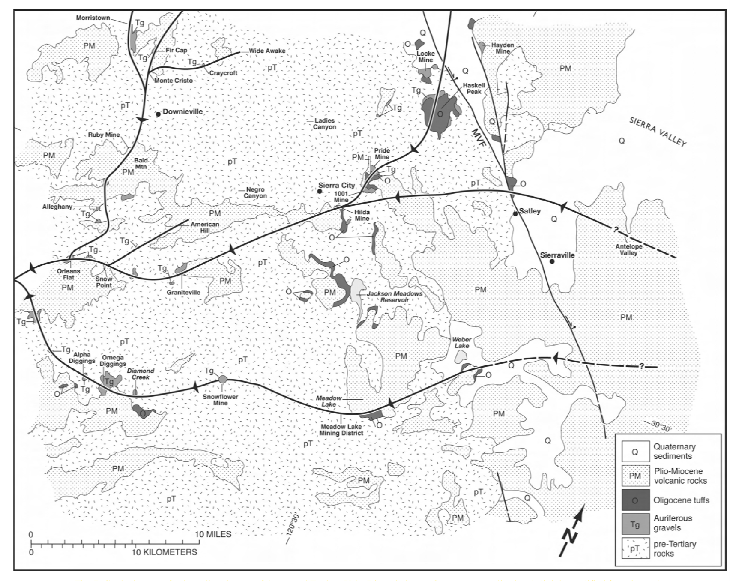
Central Branch of the Tertiary Yuba River

Slide 8
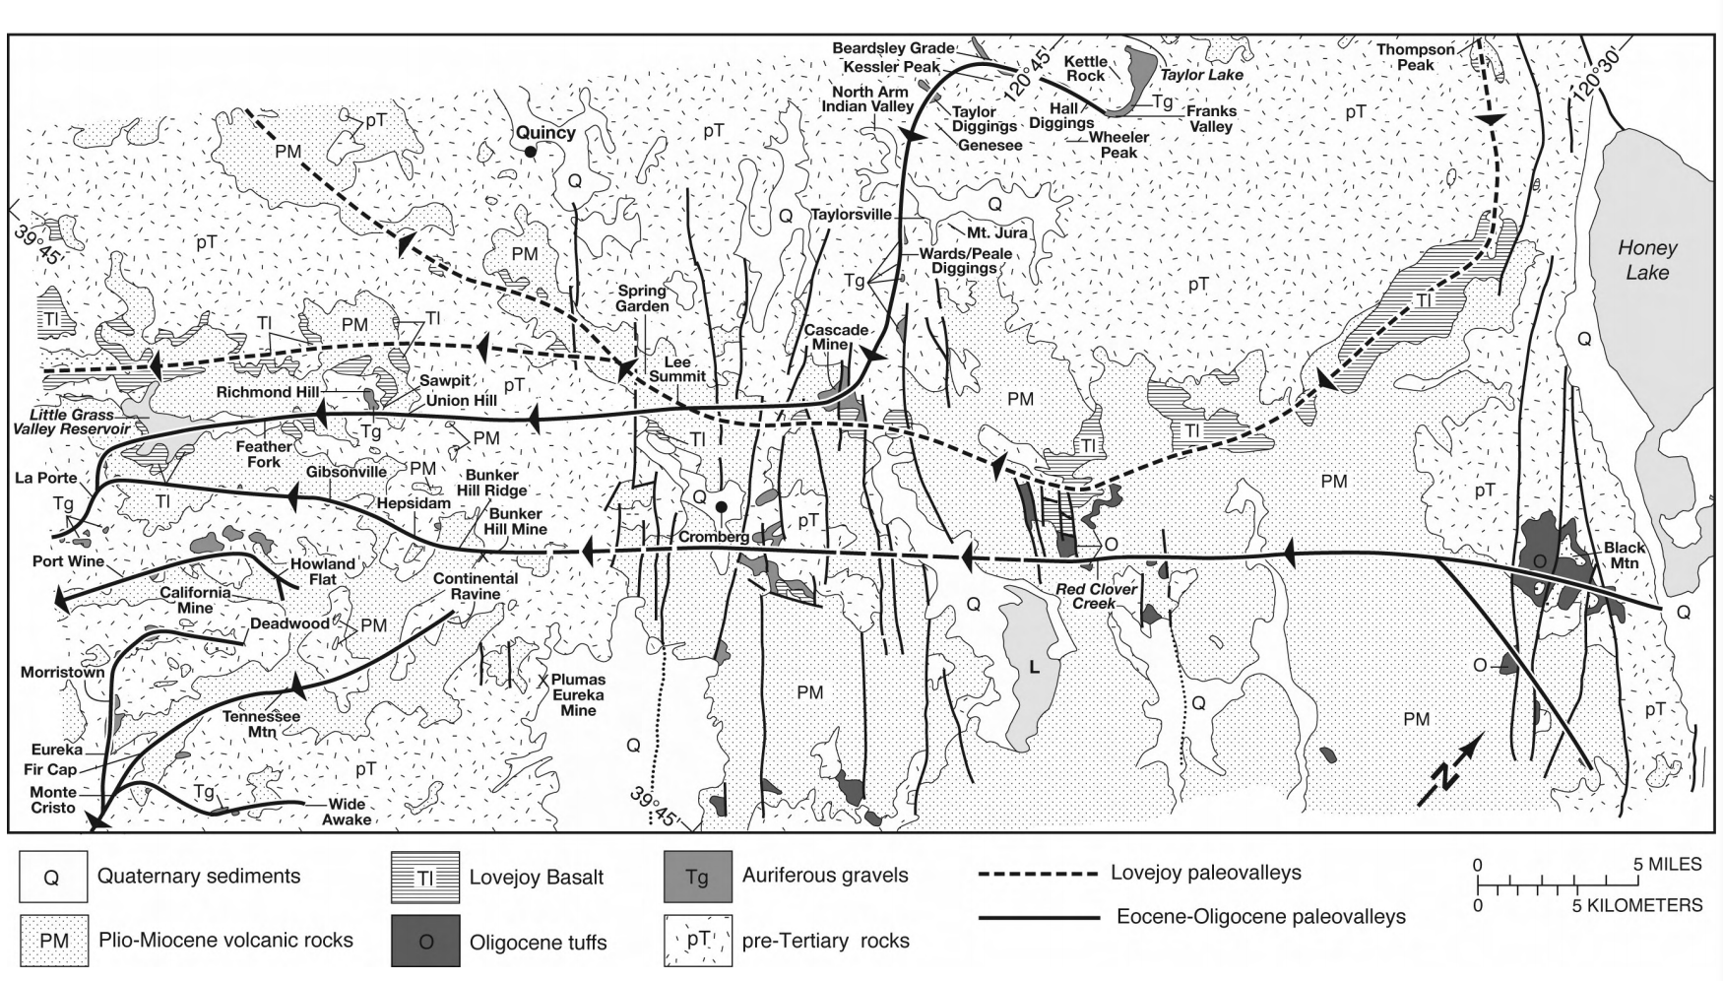
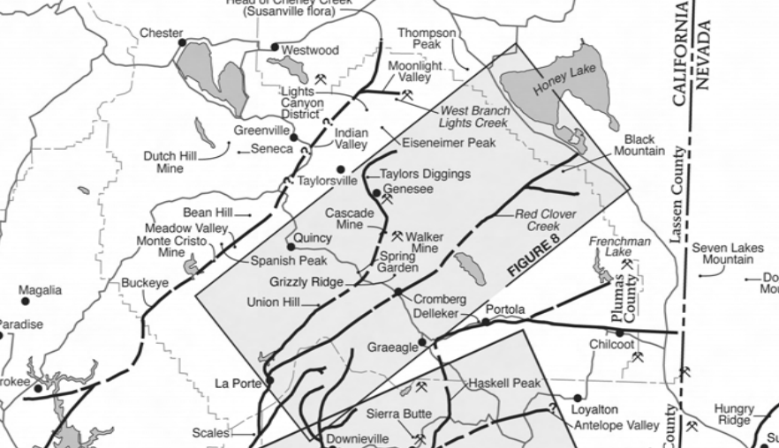
Northern Branch of the Tertiary Yuba River
Paleovalleys cut a significant amount of Auriferous gravel deposits.

Slide 9
Big picture
80-30 M years of erosion where rivers traveled from the once higher basin and range area to what is now the Sacramento valley.
During this time period (40-30 million years) lots of volcanic activity near the divide.
Uplift of the Sierra Nevada mountain range occurred.
Changed the river directions.
We can reconstruct the paleovalleys the early Yuba and American river flowed through.
This reconstruction of paleovalleys shows cutting of gold-rich soils and thus explains the abundance of gold in the Mother-Lode area.

Slide 10
My questions
Why is it easy to find gold deposits/ why isnt it more scattered?
Why do we only look at the last 80-30 My?
If we can't find the sources of many of these volcanoes, then why are we so confident in reconstructing paleovalleys around their apparent splitting?

